Slide 1
How are narratives of the use of force operating to develop national security strategies?
Angelica Martinez
John Grover
John DeRosa

Slide 2
War has its roots in the way we tell and interpret stories
What narrative structures do strategists use to legitimize the use of force?
-National Security Strategy Document Review
-National Defense University Survey
-NDU Student Focus Groups

Slide 3
Literature Review of Civil-Military Relations
Samuel Huntington's The Soldier and the State
  Civilian control, but conservative military, needed to protect values and be effective
Morris Janowitz’s The Professional Soldier
  Civilian control but military with same values needed both to preserve values and be effective
Colin S. Gray’s Fighting Talk: Forty Maxims on War, Peace, and Strategy
  Tension between civilian authority that doesn’t understand warfighting and military which may not be able to deliver on political aims
Eliot Cohen’s Supreme Command
  Unequal and often contentious dialogue between civilian authority and military

Slide 4
Literature Review of Functional Approaches
Kaufman, Sanda, Michael Elliott and Deborah Shmueli. "Frames, Framing and Reframing." Beyond Intractability. Eds. Guy Burgess and Heidi Burgess. Conflict Information Consortium, University of Colorado, Boulder. Posted: September 2003
Harre and Langenhove “Varieties of Positioning” Journal for the Theory of Social Behavior
  Positioning as the discursive construction of personal stories that make a person’s actions intelligible and relatively determinate as social acts and within which the members the conversation have a specific locations (pg. 395). Conversations have storylines and the positions people take in a conversation will be linked to these storylines (396).
Harre and Slocum, Disputes as Complex Events: On the Uses of Positioning Theory from the book Positioning Theory, Langenhove and Harre eds., (Oxford: Blackwell, 1999).
  Positioning theory as a way to reveal some of the sustaining narrative forms that nourish (or justify) conflict. It brings the dynamics of the creation of patterns of meanings to light (100).

Slide 5
Survey of NDU Class of 2017 as a Functional Approach
Trying to get at the how, the relation between the narratives of those who are being trained as strategists and the narratives the are learning
Four case studies of the use of force: Libya, Kosovo, Iraq, and Somalia.
Uses circular questions regarding:
  Presidential Narratives of the Use of Force
  National Security Advisor Recommendations for Action
  The Military’s Interpretation of the President’s story and Advisor’s Actions

Slide 6
Analytical Methodology
Dynamic 1 – Framing of the Cases (Coding of Question 1 and 2)
Frames are cognitive shortcuts that people use to help make sense of complex information. Frames provide meaning through selective simplification, by filtering people's perceptions and providing them with a field of vision for a problem.
Dynamic 2 – Positioning within Frames (narratives told in Question 3 as clustered by Dynamic 1)
Positioning self and other, relative to rights, duties and obligations, within a story-line, and a moral frame.

Slide 7
Case 1 Somalia: “We went because only the United States could help stop one of the great human tragedies of this time.”
Dynamic 1: Framing |  | Dynamic 2 Positioning: Examples and Analysis
Rationale | Method | Positioning
Humanitarian Duty | Coercion | Exercise judgement in the use of coercive (obey the rules or else) force to ensure the peaceful distribution of aid to the population.
Unique Virtue | Force | Use of limited war to achieve political objectives.
Write In Answer: Responsibility to Protect. | Coercion | Minimal force to keep atrocities from occurring. Minimal commitment of US forces in ground conflict.
Frames of Humanitarian duty are often positioned as protecting a population, often with the limited use of force.
Frames of Humanitarian duty can also be positioned as persuasive to prevent atrocity with threat of force.
Frames of Unique Virtue often positioned as the use of limited force to achieve a political goal of preventing mass murder.

Slide 8
Case 2 Afghanistan: “The United States respects the people of Afghanistan... but we condemn the Taliban regime… the Taliban regime is committing murder.”
Dynamic 1: Framing |  | Dynamic 2 Positioning: Examples and Analysis
Rationale | Method | Positioning
Self defense | Coercion | If the Taliban does not met the conditions stated by the USG, the full range of conventional and unconventional (minus nuclear) will be used to gain compliance with US demands.
Evil Enemy | Co-option | Swift, decisive multinational action.
Self defense | Coercion | Afghanistan was a self-defense action, waged to destroy AQ and prevent another 9/11 from happening.
Frames of Self defense positioned as used to compel compliance by Taliban in form of ultimatum
Frames of Evil Enemy positioned as use of multilateral force necessary to destroy irredeemable opponent
Frames of Self defense also positioned as necessary retribution and pre-emptive defense against future attacks

Slide 9
Case 3 Libya: “In the face of the world’s condemnation, Qaddafi chose to escalate his attacks, launching a military campaign against the Libyan people.”
Dynamic 1: Framing |  | Dynamic 2 Positioning: Examples and Analysis
Rationale | Method | Positioning
Humanitarian Duty | Persuasion | Regime change to stop Gaddafi, a snake and dictator
Unique Virtue | Force | Limited to air campaign; no boots on the ground
War as Last Resort. | Force | Stop Libyan government aggression against its people
Frames of Humanitarian duty are sometimes positioned as persuasive, but always as stopping Gaddafi, possibly with full regime change
Frames of Unique Virtue positioned as helping civilians but with limited military action and presence
Frames of War as Last Resort positioned as necessary to stop Libyan government from committing war crimes against its own people

Slide 10
Case 4 Kosovo: “We act to protect thousands of innocent people in Kosovo from a mounting military offensive… with our allies [we are] upholding our values, protecting our interests, and advancing the cause of peace.”
Dynamic 1: Framing |  | Dynamic 2 Positioning: Examples and Analysis
Rationale | Method | Positioning
Humanitarian Duty | Coercion | Limited to protect Kosovo from oppression
Humanitarian Duty | Co-option | Peacekeeper
Unacceptable Consequences of Appeasement. | Coercion | Capture Milosevic and eliminate capacity to wage war
Frames of Humanitarian duty are positioned as protecting civilians.
Frames of Humanitarian duty with other than “force” as the method are positioned as limited/proportional responses
Frames of Unacceptable Consequences of Appeasement are positioned as necessary to stop further genocide/only way to end the conflict

Slide 11
Comparison to NSSD Coding
Linkages exist between phase 1 and phase 2
These stories are still populating the landscape and are more often than not, being downloaded from the NSDD narratives
The survey respondents code similarly to how we coded the NSSDs

Slide 12
Survey as Retrospective and Prospective: Past Events Inform What is Possible in the Future
The NDU Survey helps us to understand how strategists understand past conflicts since they must reflect on (a) the story of why the US used force, (b) the method of force used, and (c) how those in the field (often themselves) interpreted such stories and orders.
We know from first phase those stories are being used to justify the use of force and we want to know how these stories are interacting, how we talk about them, and how they are impacting future strategies.

Slide 13
Review and Limitations
Limited Number of Respondents
Difficulties navigating two bureaucracies and two IRB processes
NDU requirement that the survey be revised to better integrate their definitions of terms and to be more grounded in scholarship they recognize (hence more clearly based off of Rubenstein’s reasons for the use of force).

Slide 14
Where to Next?
Post-Structural Focus Groups of NDU Students!

Slide 15
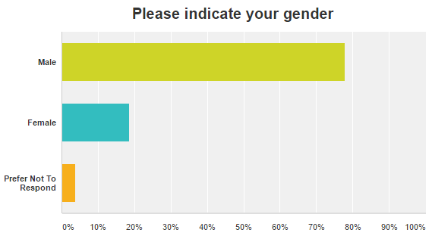
Survey Demographic Results
27 respondents

Slide 16
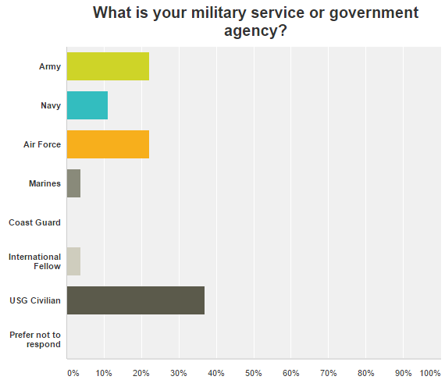
Survey Demographic Results
27 respondents

Slide 17
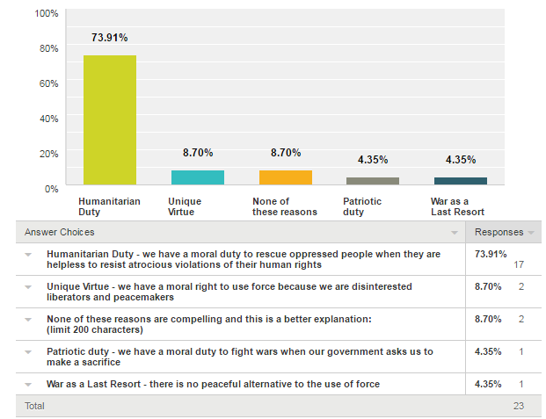
Case 1 Somalia
Dynamic 1 Framing: Rationale for the Use of Force

Slide 18
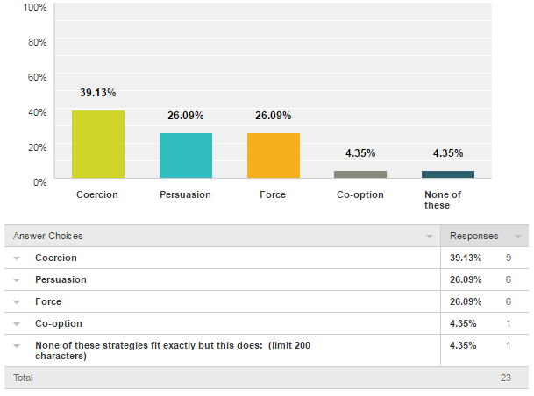
Case 1 Somalia
Dynamic 1 Framing: Method of the Use of Force

Slide 19
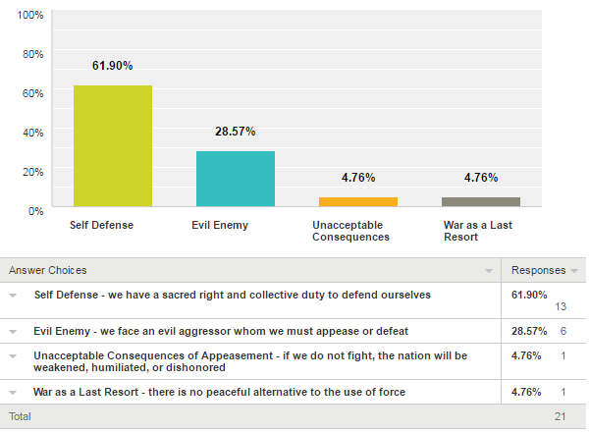
Case 2 Afghanistan
Dynamic 1 Framing: Rationale for the Use of Force

Slide 20
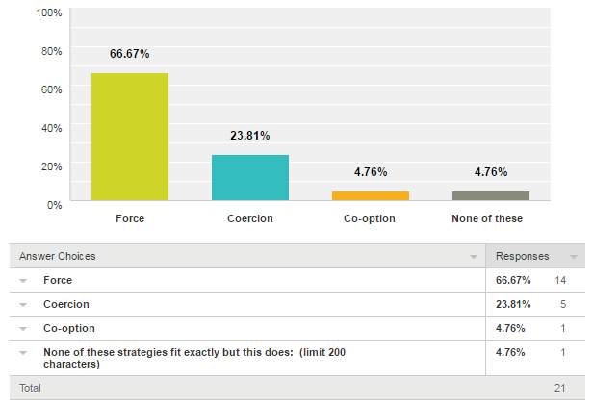
Case 2 Afghanistan
Dynamic 1 Framing: Method of the Use of Force

Slide 21
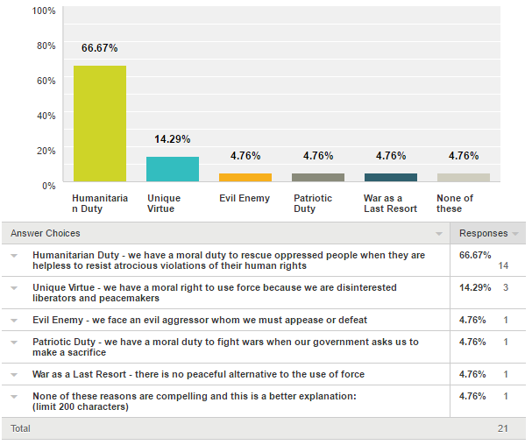
Case 3 Libya
Dynamic 1 Framing: Rationale for the Use of Force

Slide 22
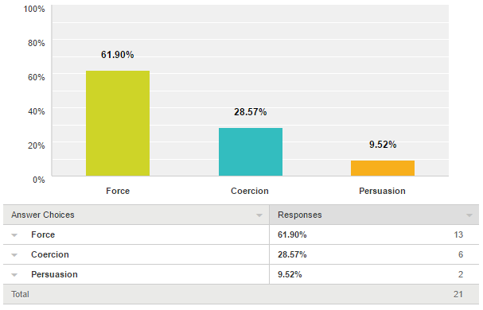
Case 3 Libya
Dynamic 1 Framing: Method of the Use of Force

Slide 23
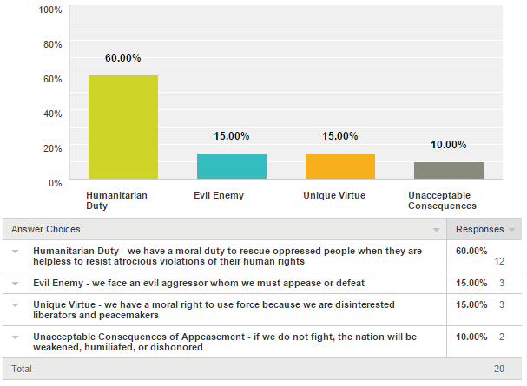
Case 4 Kosovo
Dynamic 1 Framing: Rationale for the Use of Force

Slide 24
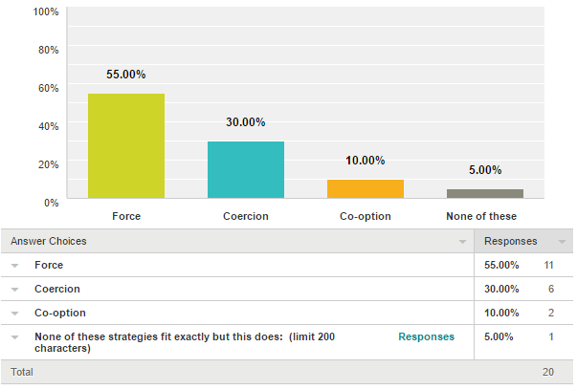
Case 4 Kosovo
Dynamic 1 Framing: Method of the Use of Force

